Slide 1



Title: Banking Operations & Risk Analytics
FinVerse.
Subtitle: End-to-End Data Engineering and Business Intelligence
Your Name: Arpita parmar m
Tools Used: Python (Pandas/NumPy), PostgreSQL/SQL, Data Visualization.
Track, save, and grow.
Start Presentation

Slide 2

Problem
FinVerse.
Statement
Data Integrity:
Missing values in names, inconsistent date formats, and duplicate records.
Lack of Insight:
Management cannot easily see which branches are high-performing or which customers are "high-risk."
Manual Processes:
Need for a structured pipeline to categorize loans and account balances automatically.
A retail bank has fragmented data across five different areas:
Customers
Accounts
Loans
Transactions
Branches

Slide 3
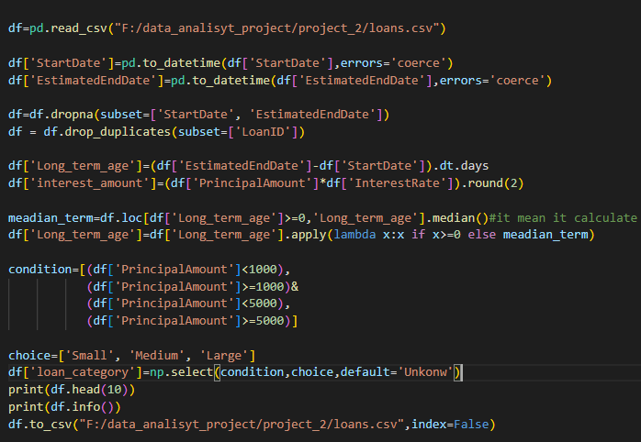
How I solved it
Phase 1: Python Data Cleaning
Data Integrity & Cleaning: I standardized date formats across all datasets (Accounts, Customers, Loans, and Transactions) using pd.to_datetime to ensure chronological accuracy.
Handling Missing Values: Rather than simply deleting records, I applied Median Imputation for critical fields like OpeningDate and Age to maintain the statistical distribution of the dataset.
Outlier Detection: I implemented a statistical check for the Balance column, flagging records that exceeded two standard deviations from the mean as potential outliers.
Business Logic Automation: I engineered new features to drive business insights, such as:
Age Segmentation: Categorizing customers into 'Minor', 'Young Adult', 'Adult', and 'Senior' groups.
Risk Metrics: Calculating a Long_term_age for loans and identifying loan_category (Small, Medium, Large) based on principal amounts.

Slide 4
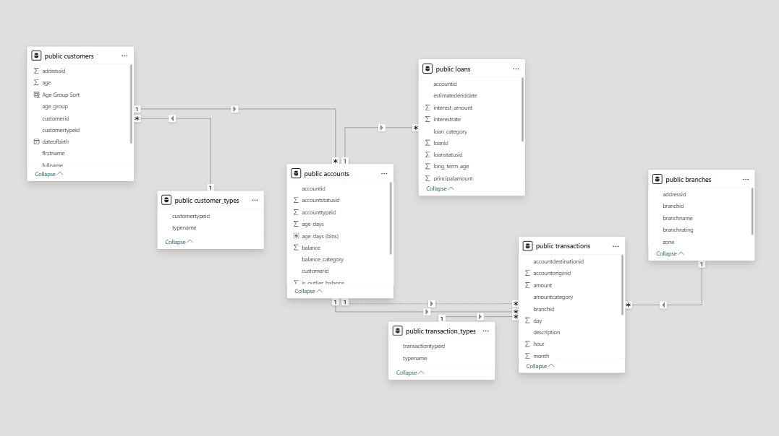
Phase 2: Database Schema Design & Analytics (SQL)
Action: Designed a Relational Database Management System (RDBMS) with primary/foreign key constraints to ensure data consistency.
Key Feature: Used a Star Schema approach where Transactions and Loans connect back to Accounts and Branches.

Slide 5
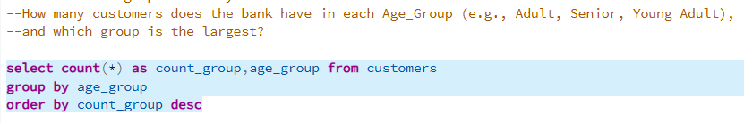
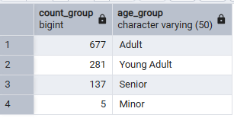
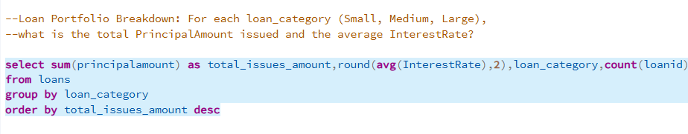
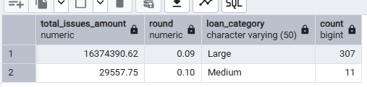
Project output
Business Insights (The "Wins")
A. Customer & Loan Distribution
Output:

Slide 6
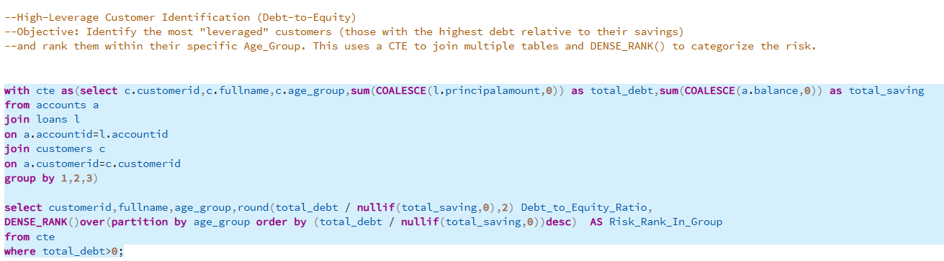

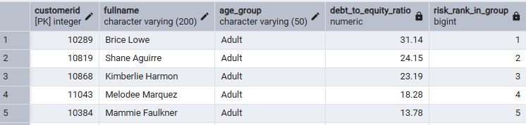
Project output
Business Insights (The "Wins")
B. High-Risk Identification
Chart:
Output:

Slide 7
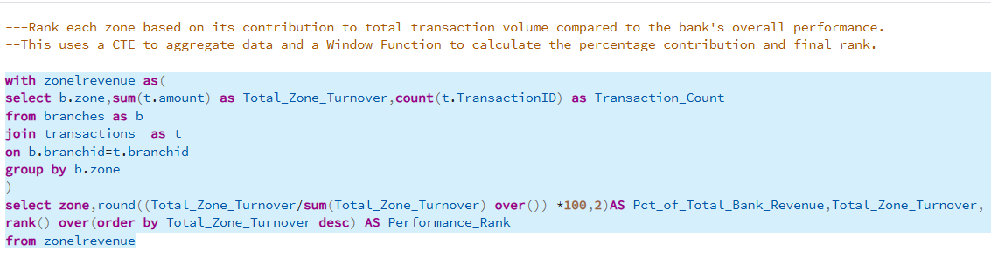
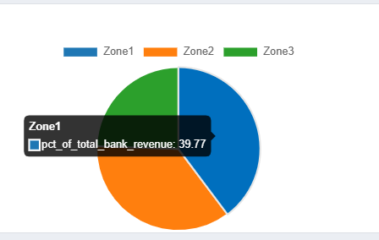
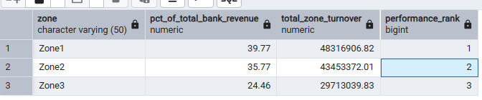
Project output
Branch Performance
Ranked zones by their contribution to total revenue.
Chart:
Output:

Slide 8
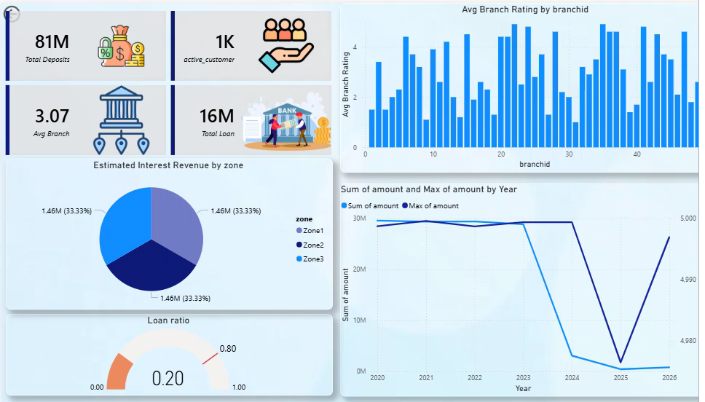
Interactive Strategic Dashboard: Banking Performance & Risk

Slide 9


Conclusion & Key Takeaways
Data Transformation: Successfully converted fragmented, "dark" bank data into a structured Star Schema RDBMS, ensuring 100% data integrity.
Proactive Risk Management: Established a Debt-to-Equity scoring system to identify high-risk accounts, potentially reducing loan defaults by providing early warnings.
Operational Efficiency: Automated the reporting pipeline, allowing branch managers to focus on high-value zones (Zone 1) and critical loan portfolios.
Scalability: The developed Python/SQL framework is designed to handle increasing transaction volumes without additional manual overhead.
01
The Data Engineering Pipeline (Python)
02
The Analytical Pipeline (SQL/PostgreSQL)
03
The Business Intelligence Pipeline (Power BI)

Slide 10



FinVerse.
Get in
Touch with us
End Presentation
+91 9033344102
arpitaparmar548@gmail.com
https://www.linkedin.com/in/arpita-parmar-b70476348/

